Slide 1
VOTING WEB APPLICATION USING DJANGO FRAMEWORK
Name: S.Dhanushiya
NM id: au951221104010
College Name: J.P.College Of Engineering

Slide 2
PROJECT OVERVIEW:
Our project harnesses Django's robust framework to launch a versatile
voting web application, enabling users to effortlessly create polls, vote,
and view instant results.
Tailored for a broad spectrum of uses, from community decisions to
entertainment votes, it showcases our adept use of Django to build
secure, user-friendly interfaces.
This initiative not only underscores our technical prowess but also our
dedication to enhancing participatory decision-making.

Slide 3
VOTIng APPLICATION:
Our voting application offers a streamlined platform for conducting a variety of
polls, from community decisions to entertainment preferences, enabling users
to cast votes and see results in real time.
Built with a focus on user engagement and security, it ensures a transparent
and accessible voting process for all participants.
This innovative tool is designed to facilitate democratic engagement and
decision-making across diverse groups, fostering a participatory culture in any
setting.

Slide 4
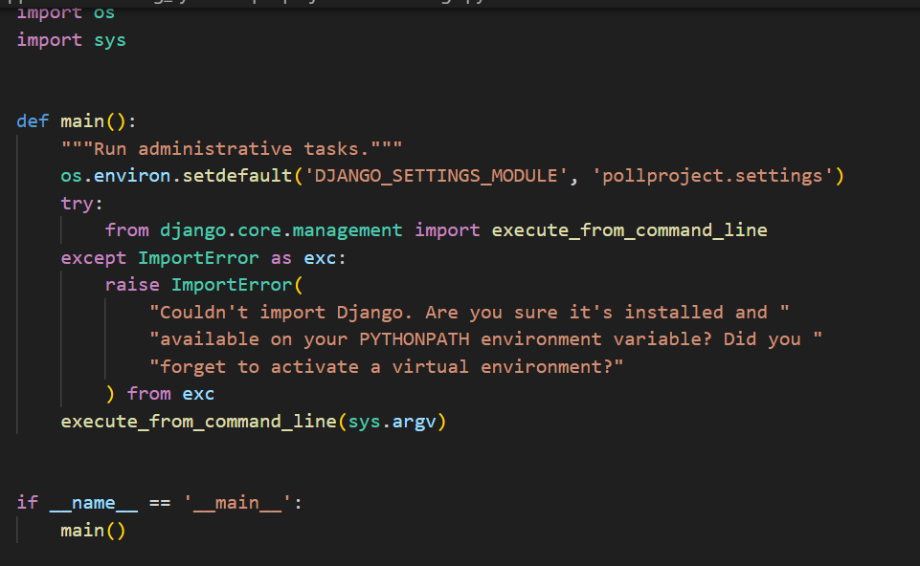
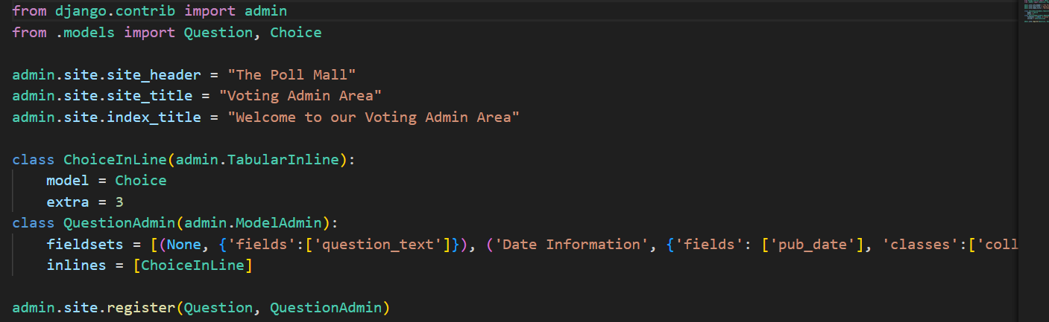
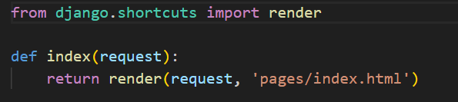
Code:

Slide 5
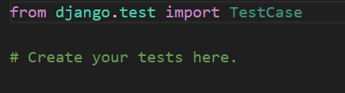

Slide 6
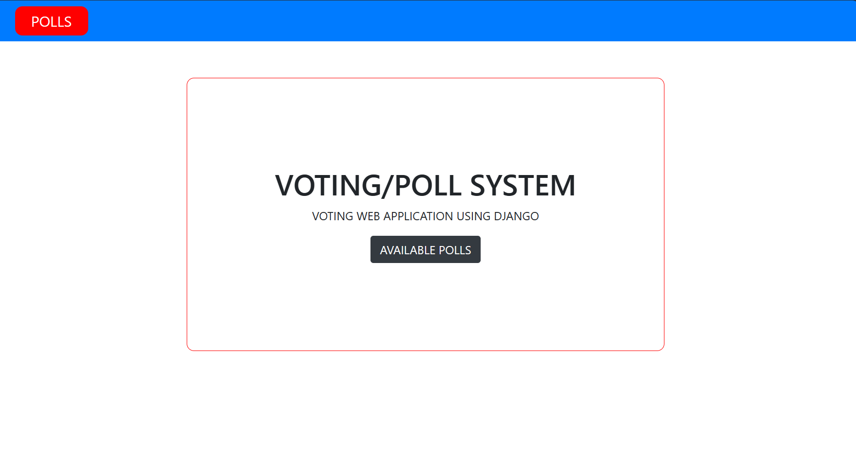

Slide 7
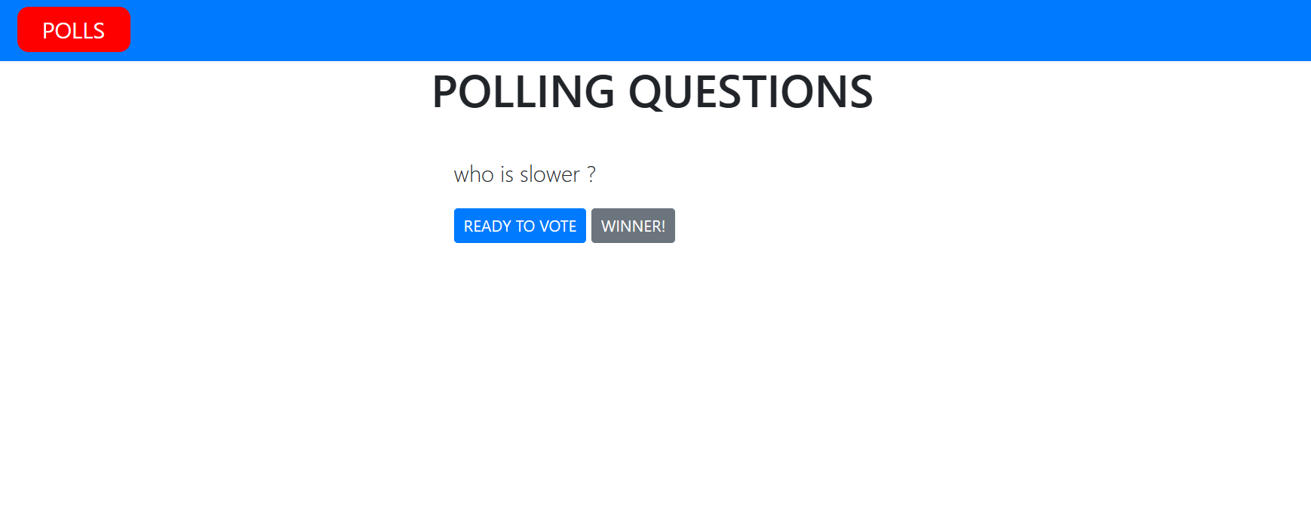

Slide 8
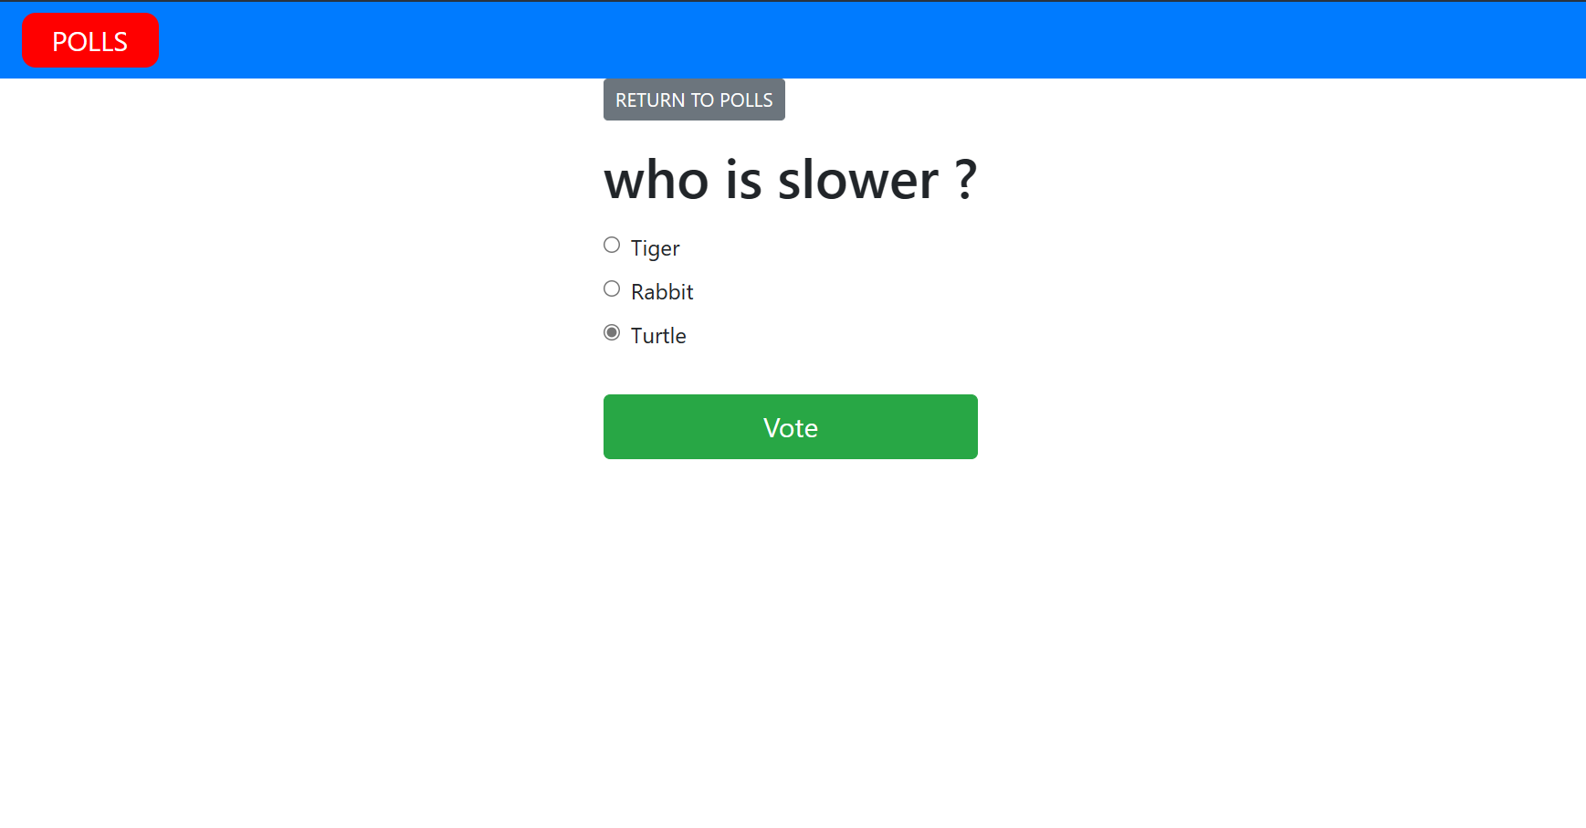

Slide 9
